Slide 1
Assessment and feedback in training and teaching

Slide 2
Teaching objective
Develop an understanding of different types of feedback,
when to give and receive feedback, and for which purpose.
Learning outcomes
Describe the differences between formative and summative assessment
Tell why frequent feedback is important
List and describe a few techniques for formative feedback

Slide 3
Peer instruction for active learning
Peer instruction for active learning (Eric Mazur): https://www.youtube.com/watch?v=Z9orbxoRofI
ConcepTests at Avanti's Learning Centre in Kanpur
https://www.youtube.com/watch?v=2LbuoxAy56o&t=2s

Slide 4
Q: what are the different ways we can categorise assessment?

Slide 5
assess prior knowledge/ mental model(s)
diagnostic
before
assessment
can be

Slide 6
pre-course
verify the target audience
at the beginning of the course
assess prior knowledge/ mental model(s)
diagnostic
before
assessment
can be

Slide 7
pre-course
verify the target audience
at the beginning of the course
assess prior knowledge/ mental model(s)
diagnostic
before
formative
assess whether learning is occurring
during
assessment
can be

Slide 8
pre-course
verify the target audience
at the beginning of the course
assess prior knowledge/ mental model(s)
diagnostic
before
formative
assess whether learning is occurring
during
assessment
can be
summative
assess if learning has occurred
after

Slide 9
pre-course
verify the target audience
at the beginning of the course
assess prior knowledge/ mental model(s)
diagnostic
before
formative
assess whether learning is occurring
during
assessment
can be
summative
assess if learning has occurred
after
measure the quality, adequacy, and impact of the course
long time after
Long term feedback

Slide 10
Assessment timeline - when and why to assess
Pre-course assessment (before the course) - verify the target audience of the course
Preventive assessment (beginning of the course) - final adjustments of the course to the reality of the participants
Formative assessment (during the course) - pilot in real time if learning is taking place
Summative assessment (right after the course) - measure and evaluate the knowledge and skills acquired
Strategic evaluation (after the course, long time after the course) - measure the adequacy, quality and impact of the course

Slide 11
Pre-course assessment - Diagnostic questionnaires
Anonymous questionnaires allow to have an idea of the level of knowledge of the whole group of learners.
Non-anonymous and personal questionnaires allow to find out if the learner has a necessary pre-required knowledge, and in the negative case indicate an appropriate teaching choice to palliate this lack.

Slide 12
Challenge (2 min)
Think about the questionnaire you filled when you registered to this course.
What is the role of this questionnaire?

Slide 13
Who would feel comfortable with giving a definition of «formative assessment»?

Slide 14
Challenge (5 min)
http://bit.ly/2VZA8Fr

Slide 15
Formative assessment
takes place during teaching and learning. Its purpose is to help both instructors and learners to become aware of what the focus should be.
its purpose is to improve the quality of student learning, not to provide evidence for evaluating or grading students.

Slide 16
5/22

Slide 17
Formative assessment
can be used to collect information about learners':
prior knowledge
> which knowledge gaps need to be filled before moving on

Slide 18
Formative assessment
can be used to collect information about learners':
mental models
> whether their mental models are correct

Slide 19
Formative assessment
can be used to collect information about learners':
goals and objectives
> if learners goals and objectives are aligned to the course's goals and outcomes

Slide 20
Formative assessment
can be used to collect information about learners':
frequent mistakes
> which types of mistakes need special attention

Slide 21
Formative Assesment can be used to:
Activate and explore prior knowledge:
activate prior knowledge
reveal accurate but insufficient prior knowledge
recognise inappropriate prior knowledge
highlight inaccurate prior knowledge

Slide 22
Formative assessment allows learners to identify their strengths and weaknessess
In other words…. to assess their own learning

Slide 23
Formative assassment allows teachers to monitor learning and detect learners difficulties
And, as a consequence, to tune/adapt/modify teaching

Slide 24
Best teachers…
constantly monitor what is happening to students as they set about learning and investigate when things do not proceed as planned or expected.
They also inquire their own practice so they might get better at ensuring that their students learn successfully.
Notes:
The best teachers constantly monitor what is happening to students as they set about learning and investigate when things do not proceed as planned or expected. They also inquire their own practice so they might get better at ensuring that their students learn successfully.

Slide 25
Reflective practice
Practice → feedback →more practice
Practice in which learners repeat similar things but in a slightly different way (repetition vs reflective practice)
Practice in which learner AND teacher modify their behaviour as a response to feedback

Slide 26
Challenge (10 min)
what kind of feedback/assessment do you know as a learner
or use as a trainer?
What type of assessment did you undertake as a learner and/or trainer?
What was its purpose in your opinion?
Was it useful to your learning or teaching?
When did the assessment happen?
Write down at least one example and discuss it with us.

Slide 27
Challenge (10 min)
Think of different kinds of formative assessment
Write down on the GDoc
Discuss it with your partner(s)

Slide 28
Formative assessment can be done in many different ways:
Asking questions to learners and getting responses orally;
Asking them to describe the strategy they would adopt to solve a problem;
Asking them to solve a problem in groups, or individually but in front of the class;
Using brainstorming and discussions;
Providing diagnostic questionnaires;
Providing MCQs with distractors.

Slide 29
Formative assessment can be done in many different ways:
Asking questions to learners and getting responses orally;
Asking them to describe the strategy they would adopt to solve a problem;
Asking them to solve a problem in groups, or individually but in front of the class;
Using brainstorming and discussions;
Providing diagnostic questionnaires;
Providing MCQs with distractors.

Slide 30
Formative assessment can come in many forms
Questionnaires
Google forms
Socrative
MentiMeter
Raise hands
Cliquer/sticky notes
MCQs
- Discussions/brainstormings
- Concept maps
- Self-assessment/self-feedback
Peer assessment
Fist of five
One up one down (+/-)
- Prova scritta
-Domande a risposta multipla
-Domande a risposta aperta
-Saggio
-Problem solving
- Prova orale
- Prova pratica
- Portfolio (consegna del)
- Report
- Griglia di valutazione (usata per dare il voto/giudizio)
- Presentazioni
- Autovalutazione
- Valutazione dei pari

Slide 35

Socrative: https://b.socrative.com/
12/22

Slide 36
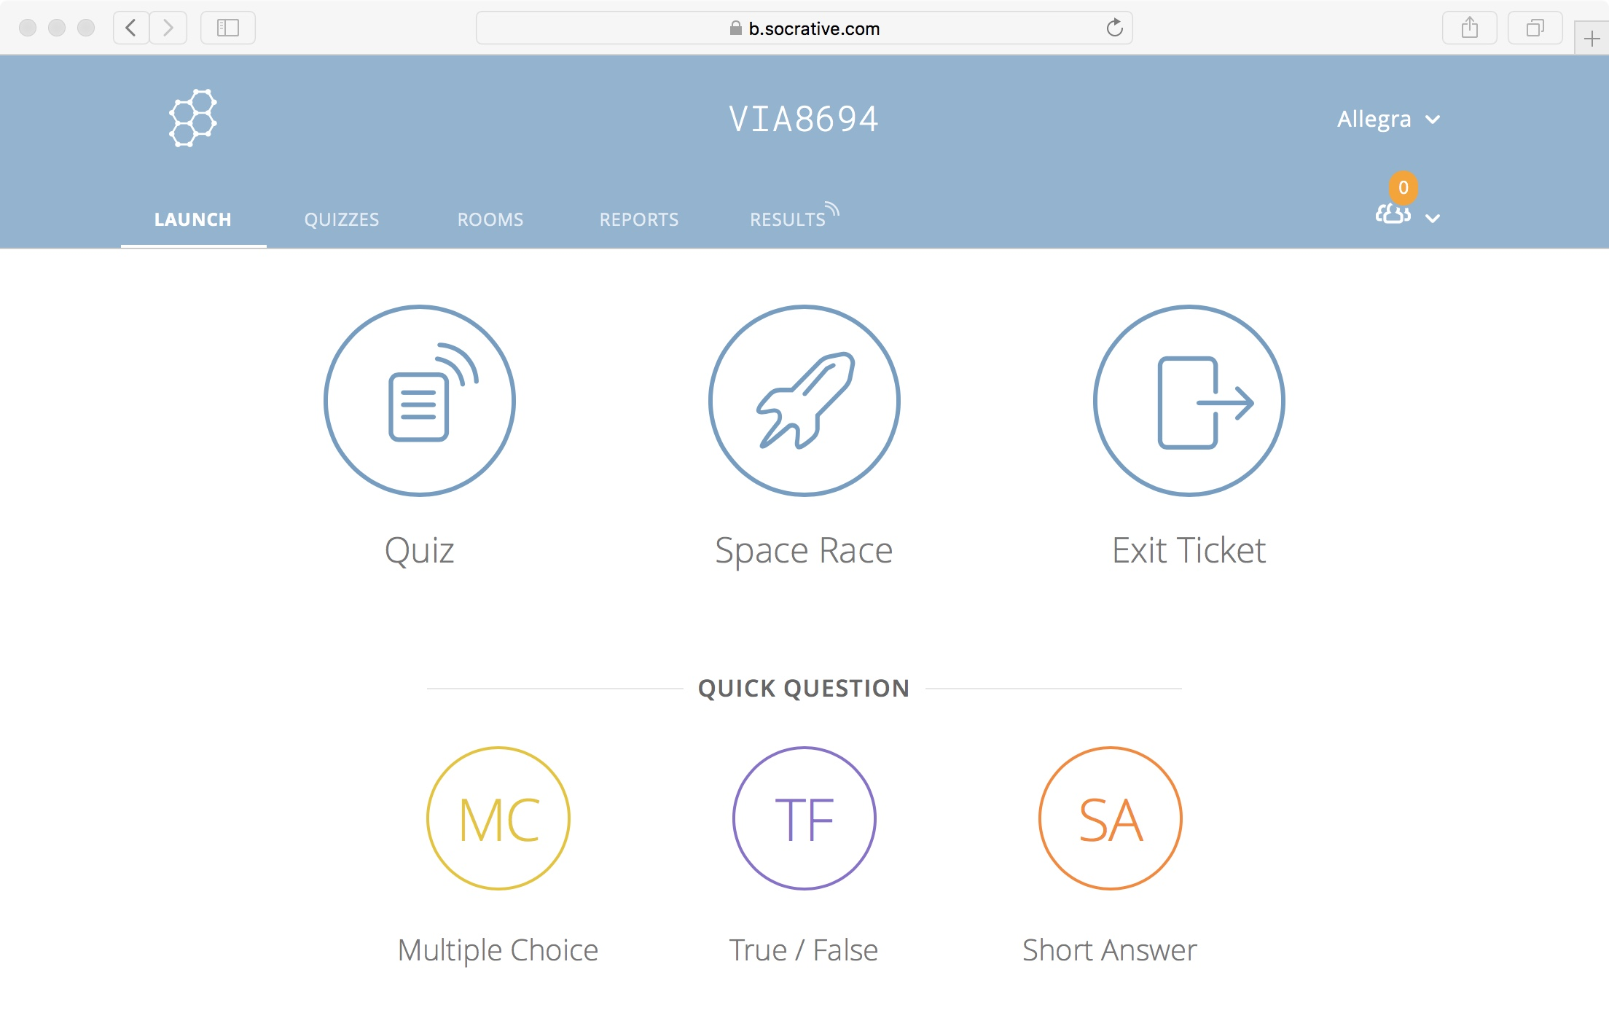
Socrative: https://b.socrative.com/

Slide 37
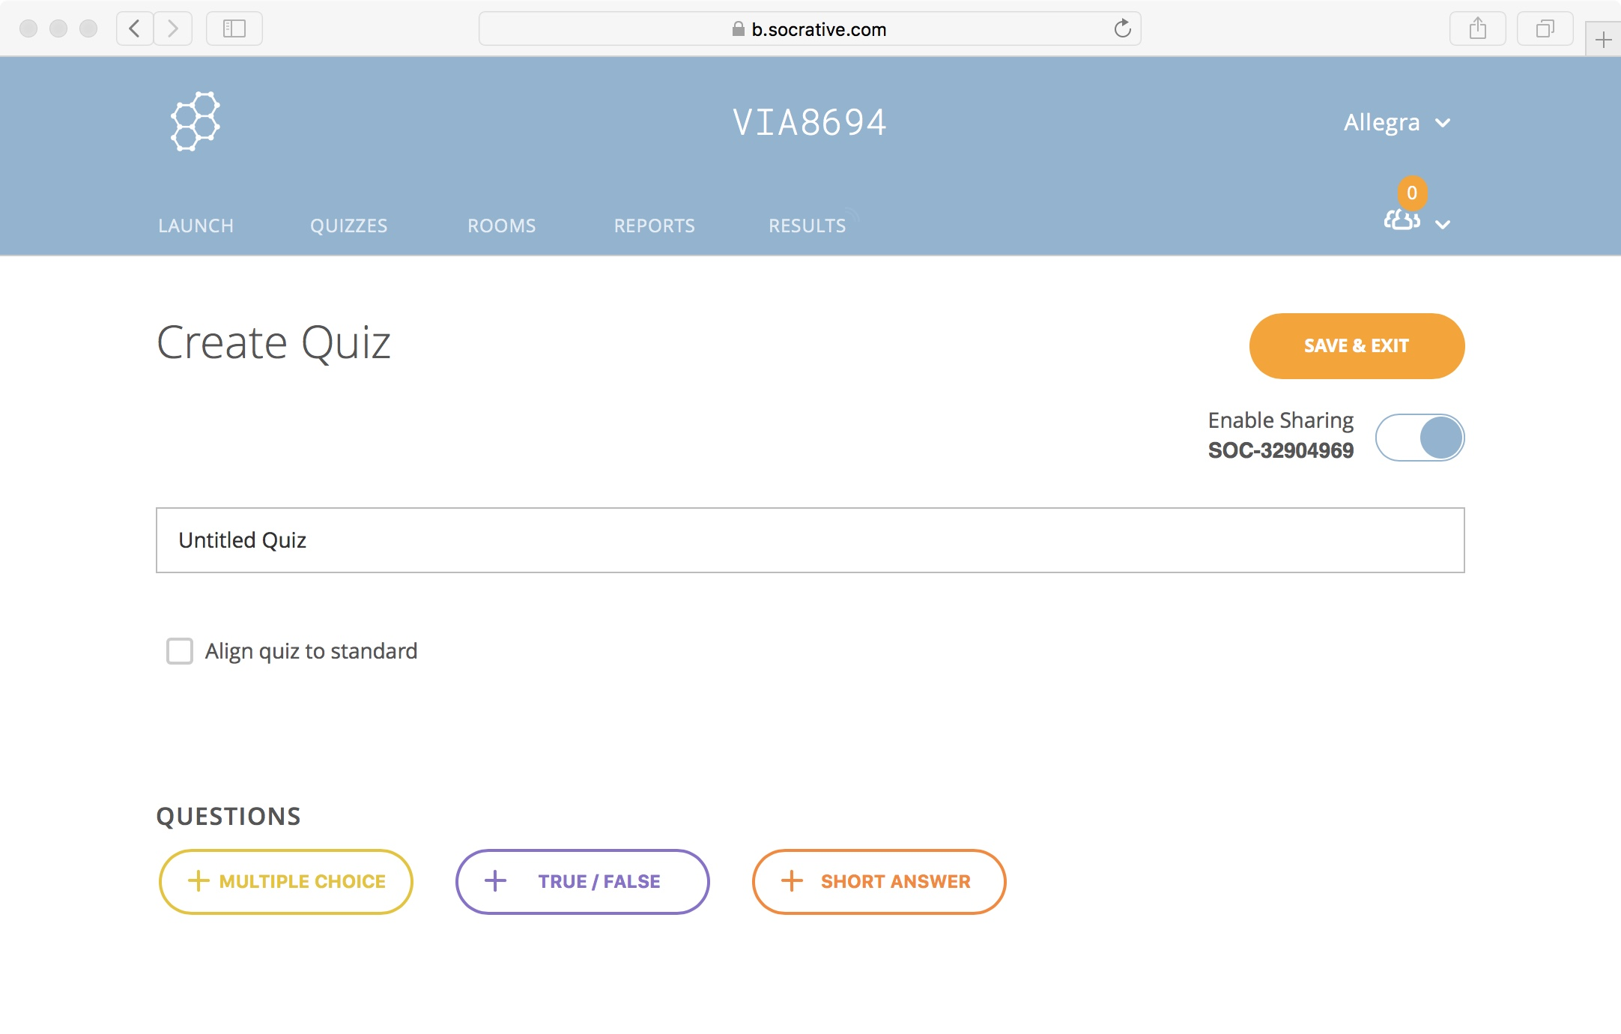

Slide 38
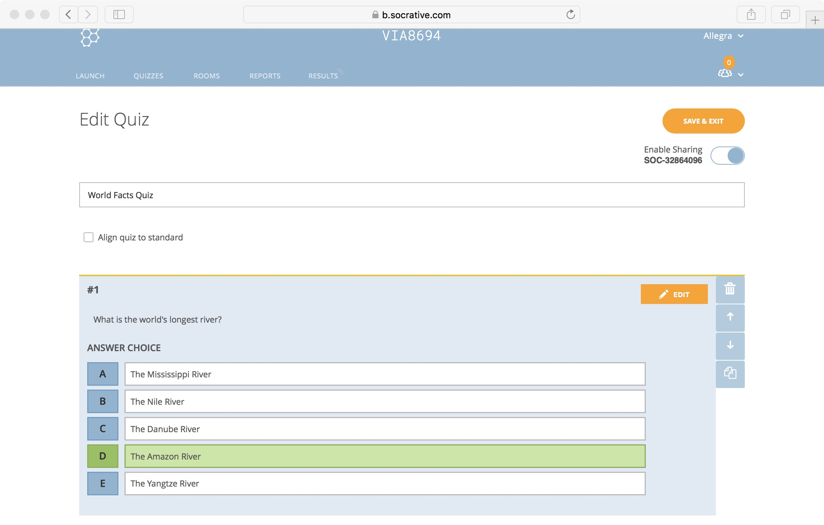

Slide 39
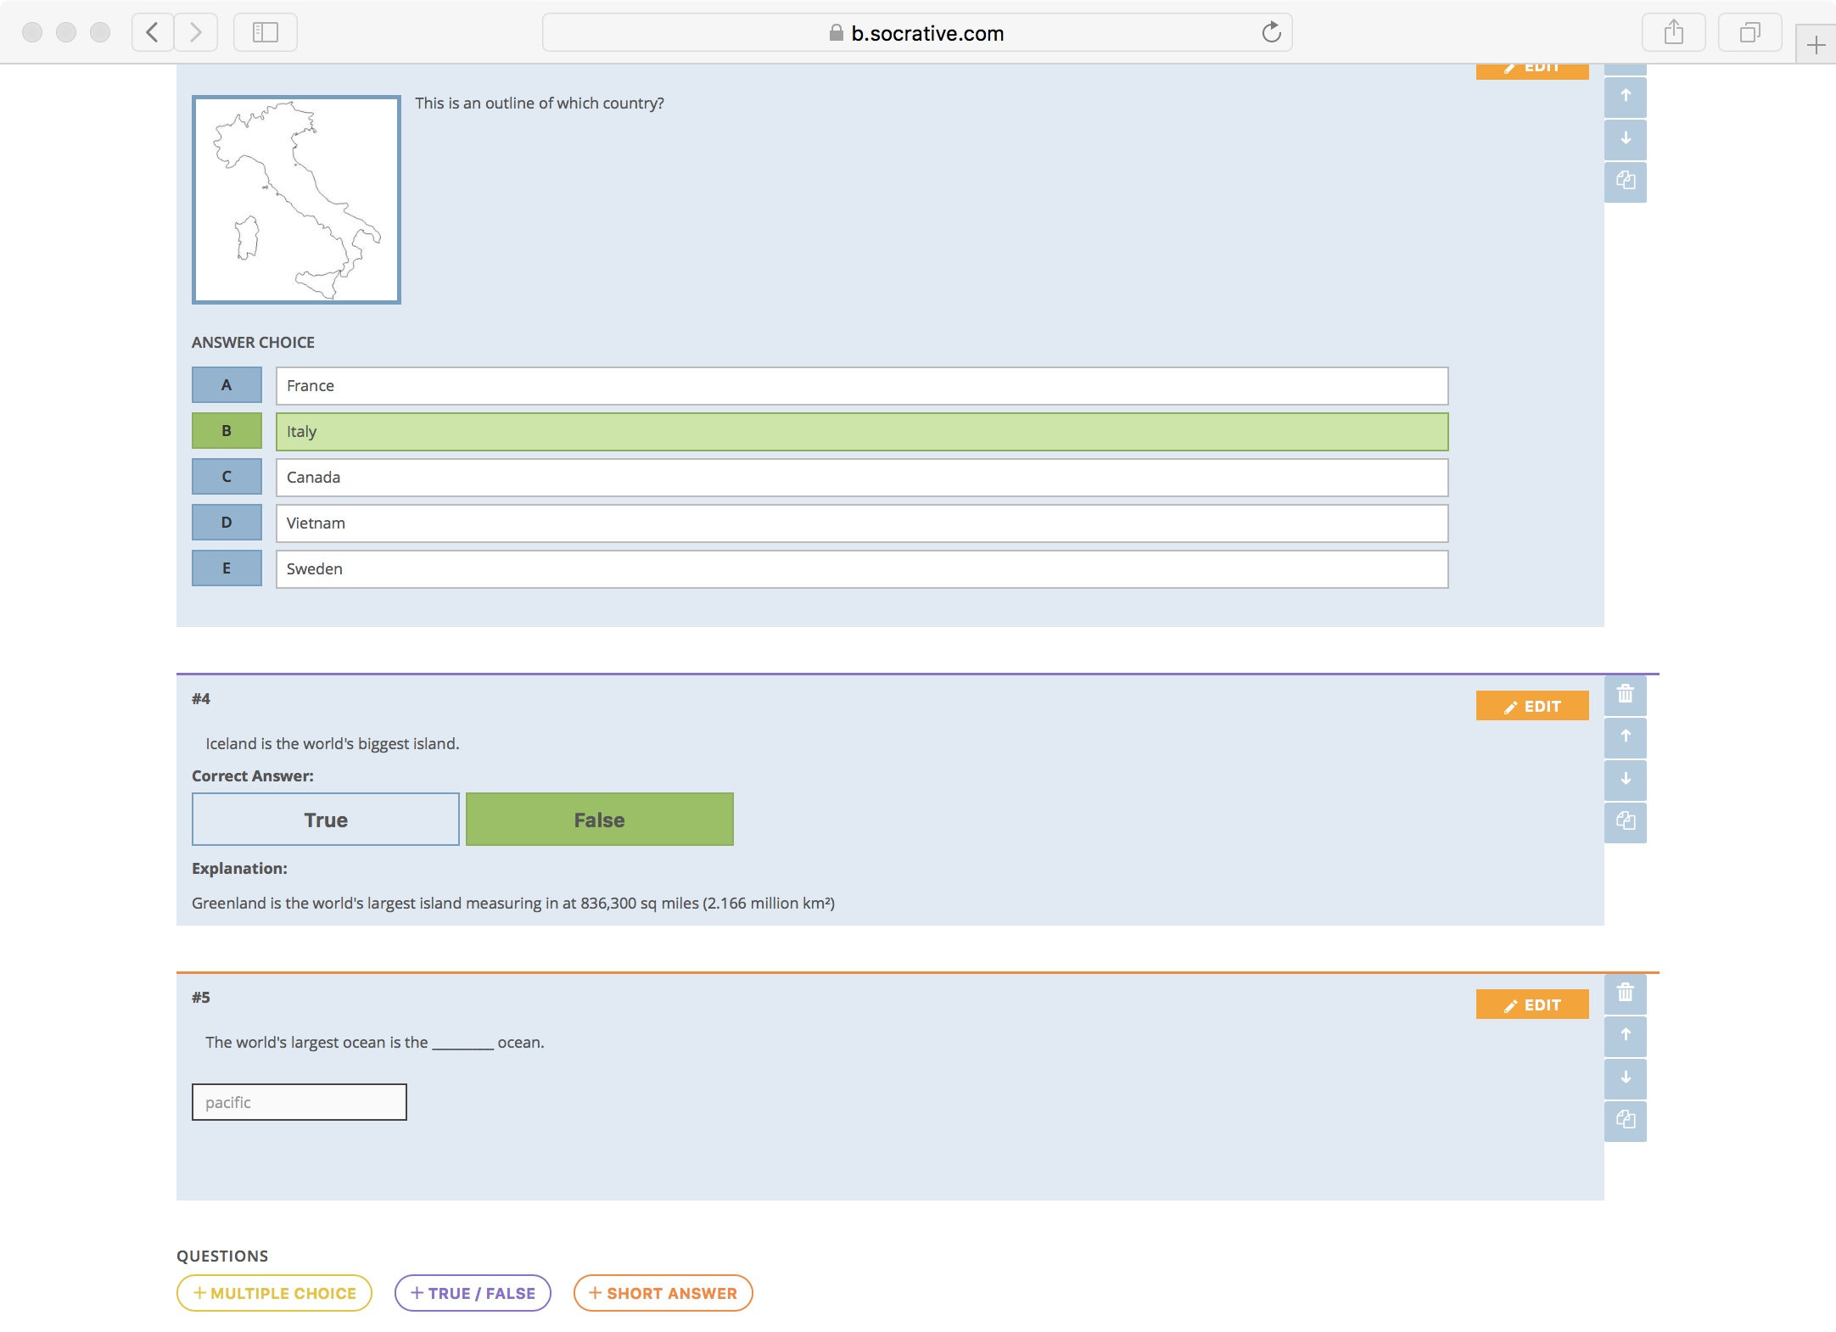

Slide 40
Formative assessment can come in many forms
Questionnaires
Google forms
Socrative
MentiMeter
Raise hands
Cliquer/sticky notes
MCQs
- One up one down (+/-)
- Portfolio
- Discussions/brainstormings
- Concept maps
- Rubrics
- Self-assessment/self-feedback
- Peer assessment
- Fist of five
- Prova scritta
-Domande a risposta multipla
-Domande a risposta aperta
-Saggio
-Problem solving
- Prova orale
- Prova pratica
- Portfolio (consegna del)
- Report
- Griglia di valutazione (usata per dare il voto/giudizio)
- Presentazioni
- Autovalutazione
- Valutazione dei pari

Slide 41
MentiMeter
https://www.mentimeter.com

Slide 42
Formative assessment can come in many forms
Questionnaires
Google forms
Socrative
MentiMeter
Raise hands
Cliquer/sticky notes
MCQs
- One up one down (+/-)
- Portfolio
- Discussions/brainstormings
- Concept maps
- Rubrics
- Self-assessment/self-feedback
- Peer assessment
- Fist of five
- Prova scritta
-Domande a risposta multipla
-Domande a risposta aperta
-Saggio
-Problem solving
- Prova orale
- Prova pratica
- Portfolio (consegna del)
- Report
- Griglia di valutazione (usata per dare il voto/giudizio)
- Presentazioni
- Autovalutazione
- Valutazione dei pari

Slide 43
MCQs: Multiple Choice Questions

Slide 44
Challenge: MCQ (5 min)
Q: what is 27 + 15 ?
a) 42
b) 32
c) 312
d) 33
Pick one wrong answer and explain misconception associated with it.

Slide 45
Design of MCQs with distractors
Versatility: Multiple choice test items can be written to assess various levels of learning outcomes, from basic recall to application, analysis, and evaluation.
Reliability: Reliability is defined as the degree to which a test consistently measures a learning outcome it purports to measure.

Slide 46
Design of MCQs with distractors
Versatility: Multiple choice test items can be written to assess various levels of learning outcomes, from basic recall to application, analysis, and evaluation.
Reliability: Reliability is defined as the degree to which a test consistently measures a learning outcome.
Validity: Validity is the degree to which a test measures the learning outcomes it purports to measure.

Slide 47
Challenge: MCQs (10 min)
Write one MCQ (in your field of teaching). Pick one :
a knowledge gap ("what")
a weakness in a practical skill ("why, when, how")
a misconception
Discuss with your partner(s).

Slide 48
Formative assessment can come in many forms
Questionnaires
Google forms
Socrative
MentiMeter
Raise hands
Cliquer/sticky notes
MCQs
- One up one down (+/-)
- Portfolio
- Discussions/brainstormings
- Concept maps
- Rubrics
- Self-assessment/self-feedback
- Peer assessment
- Fist of five
- Prova scritta
-Domande a risposta multipla
-Domande a risposta aperta
-Saggio
-Problem solving
- Prova orale
- Prova pratica
- Portfolio (consegna del)
- Report
- Griglia di valutazione (usata per dare il voto/giudizio)
- Presentazioni
- Autovalutazione
- Valutazione dei pari

Slide 49
Expectations and instructions
Definition
The teacher should clarify what kind of portfolio they expect and how to build it
Collection of learner’s works showing their progress and achievements
Portfolio
Summative assessment
Learning outcomes
It can be used by the teacher at the end of instruction to grade learners
It should show the achievement of one or more learning outcomes
Self-reflection/metacognition
Formative assessment
It should include self-reflection on each component
It should be evaluated by teacher and learner during instruction/learning

Slide 50
Formative assessment can come in many forms
Questionnaires
Google forms
Socrative
MentiMeter
Raise hands
Cliquer/sticky notes
MCQs
- One up one down (+/-)
- Portfolio
- Discussions/brainstormings
- Concept maps
- Rubrics
- Self-assessment/self-feedback
- Peer assessment
- Fist of five
- Prova scritta
-Domande a risposta multipla
-Domande a risposta aperta
-Saggio
-Problem solving
- Prova orale
- Prova pratica
- Portfolio (consegna del)
- Report
- Griglia di valutazione (usata per dare il voto/giudizio)
- Presentazioni
- Autovalutazione
- Valutazione dei pari

Slide 51
Self-assessment
reflection metacognition mindfulness
portfolio
teacher’s diary

Slide 52
Formative assessment can come in many forms
Questionnaires
Google forms
Socrative
MentiMeter
Raise hands
Cliquer/sticky notes
MCQs
- One up one down (+/-)
- Portfolio
- Discussions/brainstormings
- Concept maps
- Rubrics
- Self-assessment/self-feedback
- Peer assessment
- Fist of five
- Prova scritta
-Domande a risposta multipla
-Domande a risposta aperta
-Saggio
-Problem solving
- Prova orale
- Prova pratica
- Portfolio (consegna del)
- Report
- Griglia di valutazione (usata per dare il voto/giudizio)
- Presentazioni
- Autovalutazione
- Valutazione dei pari

Slide 53
Challenge (10 min)
Think of how you could implement peer assessment in your class
Write it in the GDoc
Discuss it with your partner(s).

Slide 54
Formative assessment can come in many forms
Questionnaires
Google forms
Socrative
MentiMeter
Raise hands
Cliquer/sticky notes
MCQs
- One up one down (+/-)
- Portfolio
- Discussions/brainstormings
- Concept maps
- Rubrics
- Self-assessment/self-feedback
- Peer assessment
- Fist of five
- Prova scritta
-Domande a risposta multipla
-Domande a risposta aperta
-Saggio
-Problem solving
- Prova orale
- Prova pratica
- Portfolio (consegna del)
- Report
- Griglia di valutazione (usata per dare il voto/giudizio)
- Presentazioni
- Autovalutazione
- Valutazione dei pari

Slide 55
Fist of five feedback

Slide 56
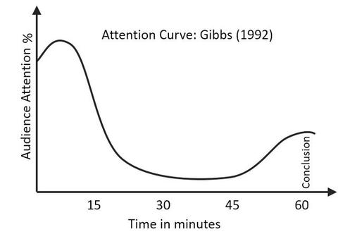
Formative assessment should be frequent
Ideally every 5 min
At least gni 10-15 min
Attention span: 10-15 min
Refocus attention

Slide 57
Systematic immediate feedback
When?
Ideally at natural breakpoints such as ending an exercise, shifting to a different subject and right after a wrap-up session.
How?
It should be very focused and expedite in execution. The instructor should think of a clearly stated question that has a binary (Yes/no) or garaded (0-5) response.
This is Instant Feedback.

Slide 58
Challenge: benefits of Instant Feedback (5 min)
What are the benefits of instant feedback:
for learners
for trainers
write them down, one benefit per post-it

Slide 59
Feedback from learners
assessing learner reactions to teachers and teaching thus providing context-specific feedback that can improve teaching within a particular course;
assessing learner reactions to class activities, assignments, and materials thus giving instructors information that will help them improve their course materials and assignments;
assessing learner reactions to course organisational aspects, thus providing the organiser information that will help him or her to improve the course organisation;

Slide 60
Feedback from learners
I’ve understood what formative assessment is and I have ideas on how to apply it ib my courses
Not clear how to write learning outcomes
22/22

Slide 61
Short term feedback assessment of training quality,
participant and instructor performance
It happens immediately at the end of the course with the purpose to measure the trainees’ perception of:
the quality of the training and its organisational aspects,
the trainer’s capacity to teach (performance),
the adequacy of the training to their expectations
the strengths and weaknesses of course.

Slide 62
Challenge (10 min)
Fill in the short term questionnaire for this course
http://bit.ly/2Xgr3cI

Slide 63
Task:
Look at Feedback Questionnaires used in ELIXIR workshops.
The type of questionnaire we developed for ELIXIR Italy courses: Feedback questionnaire for the ELIXIR Italy course on "NGS for evolutionary biologists: from basic scripting to variant calling" (Rome, 23-27 November 2015). It is adapted to each new course.
The type of questionnaire used to assess the quality of bioinformatics courses organised and delivered by the Gulbenkian Training Programme in Bioinformatics at the Instituto Gulbenkian de Ciência: Feedback questionnaire for the course on "Bioinformatics using Python for Biomedical Researchers" (Oeiras, PT July 11th – July 15th 2016)
Common shared questions used by most of the ELIXIR Nodes (countries).

Slide 64
Long term post-course feedback
The assessment of impacts that endure.
Long term assessments (over 6 months after a course) are rather difficult.

Slide 65
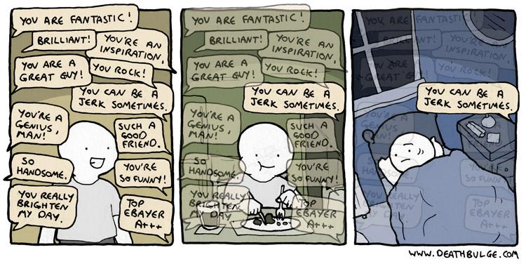
Feedback is hard

Slide 66
Dealing with (bad) feedback
Trainees feedback should be considered along other forms of quality evidence:
Review what they have effectively learned (in exams)
Consider your own experience of teaching
Discuss with colleagues and friends
Look at the feedback from past sessions of the same course
Look at the response rates
Look at the counter examples (contradictions)
Look at the repetitive patterns (not at only one single answer)

Slide 67
Dealing with (bad) feedback
Breath deeply
Humans focus more on negative feedback than on positive (you are not alone)
Try to see the point in the criticism, learn from it
Don’t take it personally (easier said than done). Try to focus on what they say about what you do (not who you are)

Slide 68
Discussions / feedback
Listen actively and attentively
Ask for clarification if you are confused
Do not interrupt one another
Challenge one another, but do so respectfully
Critique ideas, not people
Do not offer opinions without supporting evidence
Take responsibility for the quality of the discussion
Build on one another ’s comments; work toward shared understanding.
Do not monopolise discussion.
Speak from your own experience, without generalizing.
If you are offended by anything said during discussion, acknowledge it immediately.

Slide 69
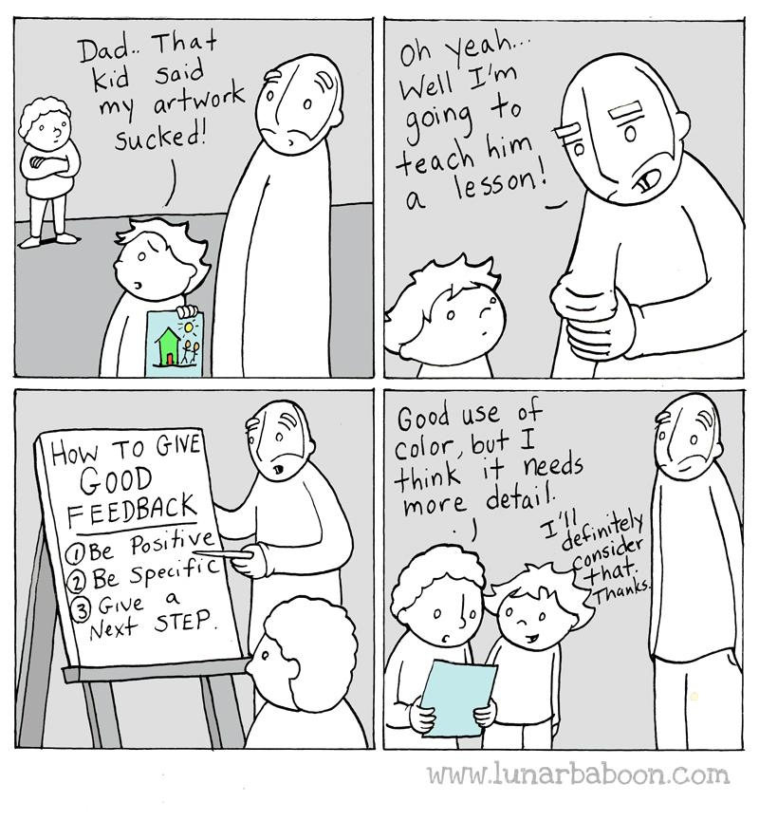
Learn and teach others how to give good feedback

Slide 71
Align summative assessment to levels of complexity

Slide 72
Potential tools for summative assessment
Questionnaires
Google forms
Socrative
MentiMeter
Raise hands
Cliquer/sticky notes
MCQs
- One up one down (+/-)
- Portfolio
- Discussions/brainstormings
- Concept maps
- Rubrics
- Self-assessment/self-feedback
- Peer assessment
- Fist of five
- Written test
- MCQ
- Open ended questions
- Essay
- Problem solving
- Oral test
- Practical test
- Portfolio
- Report
- Rubrics
- students’ presentations
- Self-evaluation
- Peer assessment

Slide 73
Rubrics

Slide 74
What is a Rubric?
A rubric is a scoring tool used to evaluate student performance on various types of assignments

Slide 75
What is a rubric?
A tool almost exclusively used to construct and grade assignments
Typically task/assignment-specific
Articulates all learning goals or skills required in the work product, plus:
Specific continuum of descriptors from poorest to best performance (grade)
Must lay out exactly what a student is supposed to be doing/showing they can do, in a given assignment

Slide 76
A rubric has 4 basic elements:
Task or Assignment Description - describes the assignment/ projects etc.
Criteria - categories of student behavior being measured
Levels - degrees of completion, success, performances, etc.
Standards for Performance - describe the intersection of levels and criteria

Slide 77
https://www.mghihp.edu/faculty-staff-faculty-compass/rubrics

Slide 78
ASSIGNMENT:

Slide 79
How to construct a Rubric
1 | Define your assignment or project (task description) | Clearly define the assignment, including the topic, the process that students will work through, and the product they are expected to create
2 | Define the key criteria that you are interested in | These are the observable and measurable characteristics of the task
3 | Establish levels and develop a scoring scale (top row) | Determine how many performance levels you want to use. These can be a grade or descriptive levels (outstanding, acceptable, not acceptable, etc.). Whichever you choose, focus on positive, non-judgmental terms (mastery, partial mastery, progressing, emerging, etc.).
4 | Establish clear standards for performance and define for each criteria (cells) | Avoid relying on comparative language when distinguishing standards across performance levels. E.g., don’t define the highest level of performance as ‘thorough and accurate’ and the middle level as ‘less thorough and less accurate’. Find qualities and descriptors that are unique to each performance standard.
Notes:
1. Define your assignment or project (task description) Clearly define the assignment, including the topic, the process that students will work through, and the product they are expected to create.
2. Define the key criteria that you are interested in such as coherence, content, and organization for a writing assignment (left column) For example, what do you mean by coherence? What does coherent writing look like? These are the observable and measurable characteristics of the task.
3. Decide what type of rubric to use (holistic or analytical) Choose a type of rubric based on the assignment and what you are interested in evaluating.
4. Establish levels and develop a scoring scale (top row) Determine how many performance levels you want to use (usually 3 or 4). These can be a grade (A - D/F) or descriptive levels (outstanding, acceptable, not acceptable, etc.). Whichever you choose, focus on positive, non-judgmental terms (mastery, partial mastery, progressing, emerging, etc.). Other performance level examples include:
Proficient, intermediate, novice
exemplary, competent, beginning
exemplary, competent, not yet competent
excellent, good, developing
1, 2, 3
strong, satisfactory, marginal
Be sure to clearly define the differences between the score levels. Additionally, levels should be consistent across all key criteria for an analytic rubric. For example, a score of 4 for one area should be comparable to a score of 4 in another area.
5. Establish clear standards for performance and define for each criteria (cells) Defining the standards for performance in analytical rubrics can be challenging. Try this technique: After you write your first paragraph of the highest level, circle the words in that paragraph that can vary. These words will be the ones that you will change as you write the lower-level performances. Avoid relying on comparative language when distinguishing standards across performance levels. For example, don’t define the highest level of performance as ‘thorough and accurate’ and the middle level as ‘less thorough and less accurate’. Find qualities and descriptors that are unique to each performance standard. Here is a list of concept words that convey various degree of performance:
Depth... Breadth... Quality... Scope... Extent... Complexity... Degrees... Accuracy
Presence to absence
Complete to incomplete
Many to some to none
Major to minor
Consistent to inconsistent
Frequency: always to generally to sometimes to rarely

Slide 80
Rubrics: keep in mind that…
Students need not to say the same things in the same ways to achieve the same grade
Grades are based not on content but on the abilities required and how well they are demonstrated
Notes:
Rubrics are tools for teaching and learning. They are almost exclusively used to construct and grade assignments. This type of grading is very rare in the sciences, where most exams and homework involve “getting the right answer the right way”, rather than “justifying how you came to a conclusion”, which is more common in the social sciences, arts, and humanities. Rubrics tend to be much more subjective in grading, but they have important features that are worth exploring.
Firstly, a rubric must lay out exactly what a student is supposed to be doing/showing they can do, in a given assignment. These are often the rows. E.g., use correct grammar; support a thesis statement (first sentence of an essay); consider multiple perspectives; etc. Importantly, an essay can have virtually ANY topic, but these features of what the student needs to show they can do will be discernable from every essay. Students do not need to say the same things in their essays, in the same ways, to achieve the same grade; grades are based not on content but on the abilities required and how well they are demonstrated (with whatever the student chooses to write about).

Slide 81
Short Term feedback questionnaire https://www.surveymonkey.co.uk/r/XLMJZSC http://bit.ly/2Xgr3cI

